Slide 1
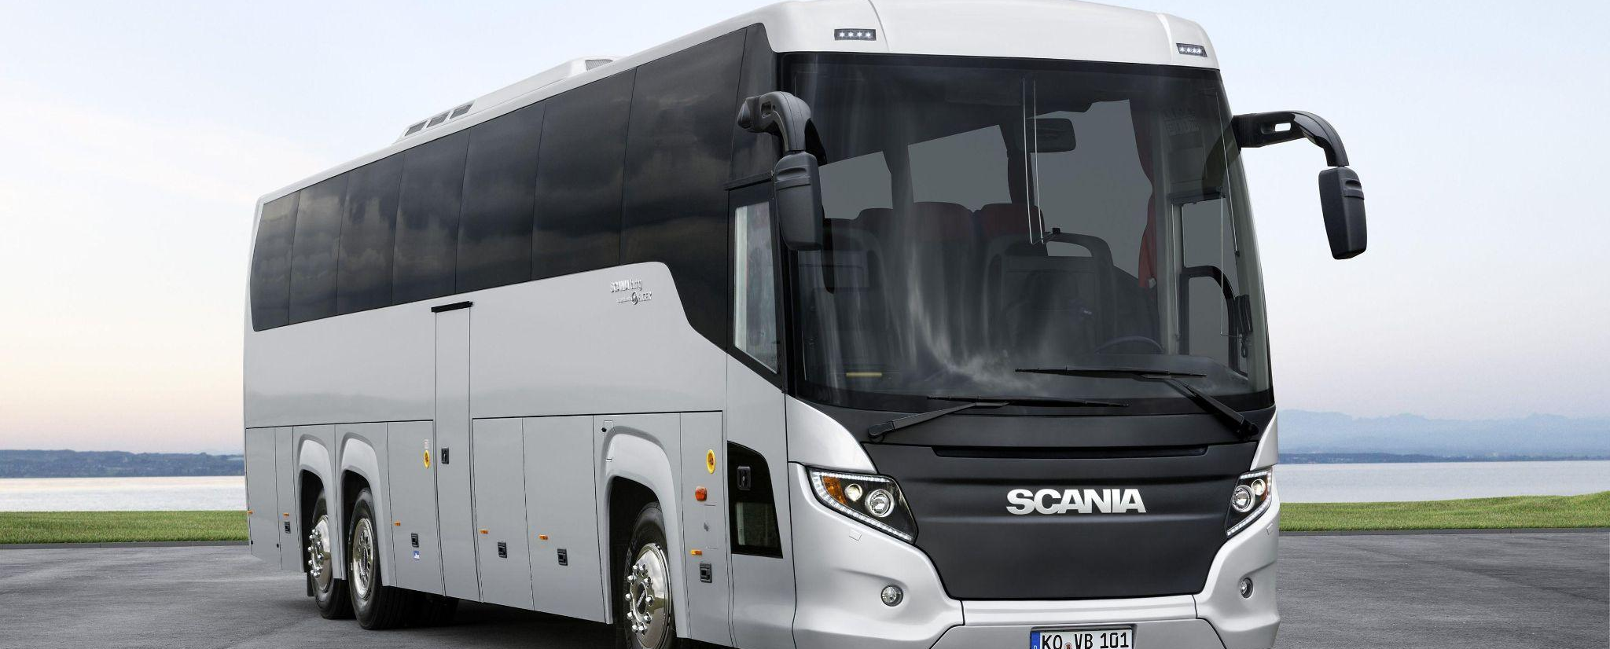
BUS MANAGEMENT SYSTEM
Supervised by
Rubayea Ferdows
Assistant Professor
Department Of CSE (IUBAT)

Slide 2
Prepared by, Stranger 4.0 Section A
Table of contents
Name | ID
MD Shahriar Hoque | 21103092
Touhid Ahmed | 21103019
Sadia Hossan | 21103009
Nusrat Jahan | 21103010
Introduction
Existing System
Objectives
Tools
Functional Requirement
Non Functional Requirement
Why Using This Model?
ER Diagram
Use Case Diagram
Context Diagram
Data Flow Diagram
Conclusion

Slide 3
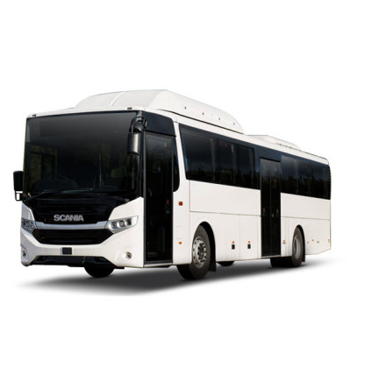
Introduction
Online bus booking system is windows based application that works within centralized network. It provides facility to reserved seats , cancellation of seats and different type of enquiry which need an instant and quick reservation .
E-ticket is the easier and quickest way to take bus.
Example: Hanif, sohoz.com

Slide 4
Existing System
In this phase, we have analyzed the existing systems and investigated problems associated with it. We understood the limitations of the existing system and got a clear idea of the requirements and need for a new system.

Slide 5
Objectives
After the requirements have been determined , the necessary specifications for the hardware , software , people , and data resources , and the information products that will satisfy the functional requirements of the proposed system can be determined .
After that we made a blueprint for the proposed system

Slide 6
Tools
Hardware Requirements
PC with dual core or more processor
1 GB Ram or above
180 Gb HDD or above
Software Requirements
Neatbeans
Scene builder
Xampp Server

Slide 7
Functional Requirement
Login User
Show Available buses
Buy Tickets
Add remove buses
Pay
Login Out

Slide 8
Non Functional Requirement
Reliability: The application should be reliable and it should generate all updated information in correct order.
Availability : Application will be available and working properly for all the time .
Security : Uses higher security for saving data

Slide 9
Why Using This Model?
Generates working software quickly and early during the software life cycle.
This model is more flexible-less costly to change scope and requirements.
It is easier to test and debug during a smaller iteration.
In this model customer can respond to each built.
Lowers initial delivery cost.

Slide 10
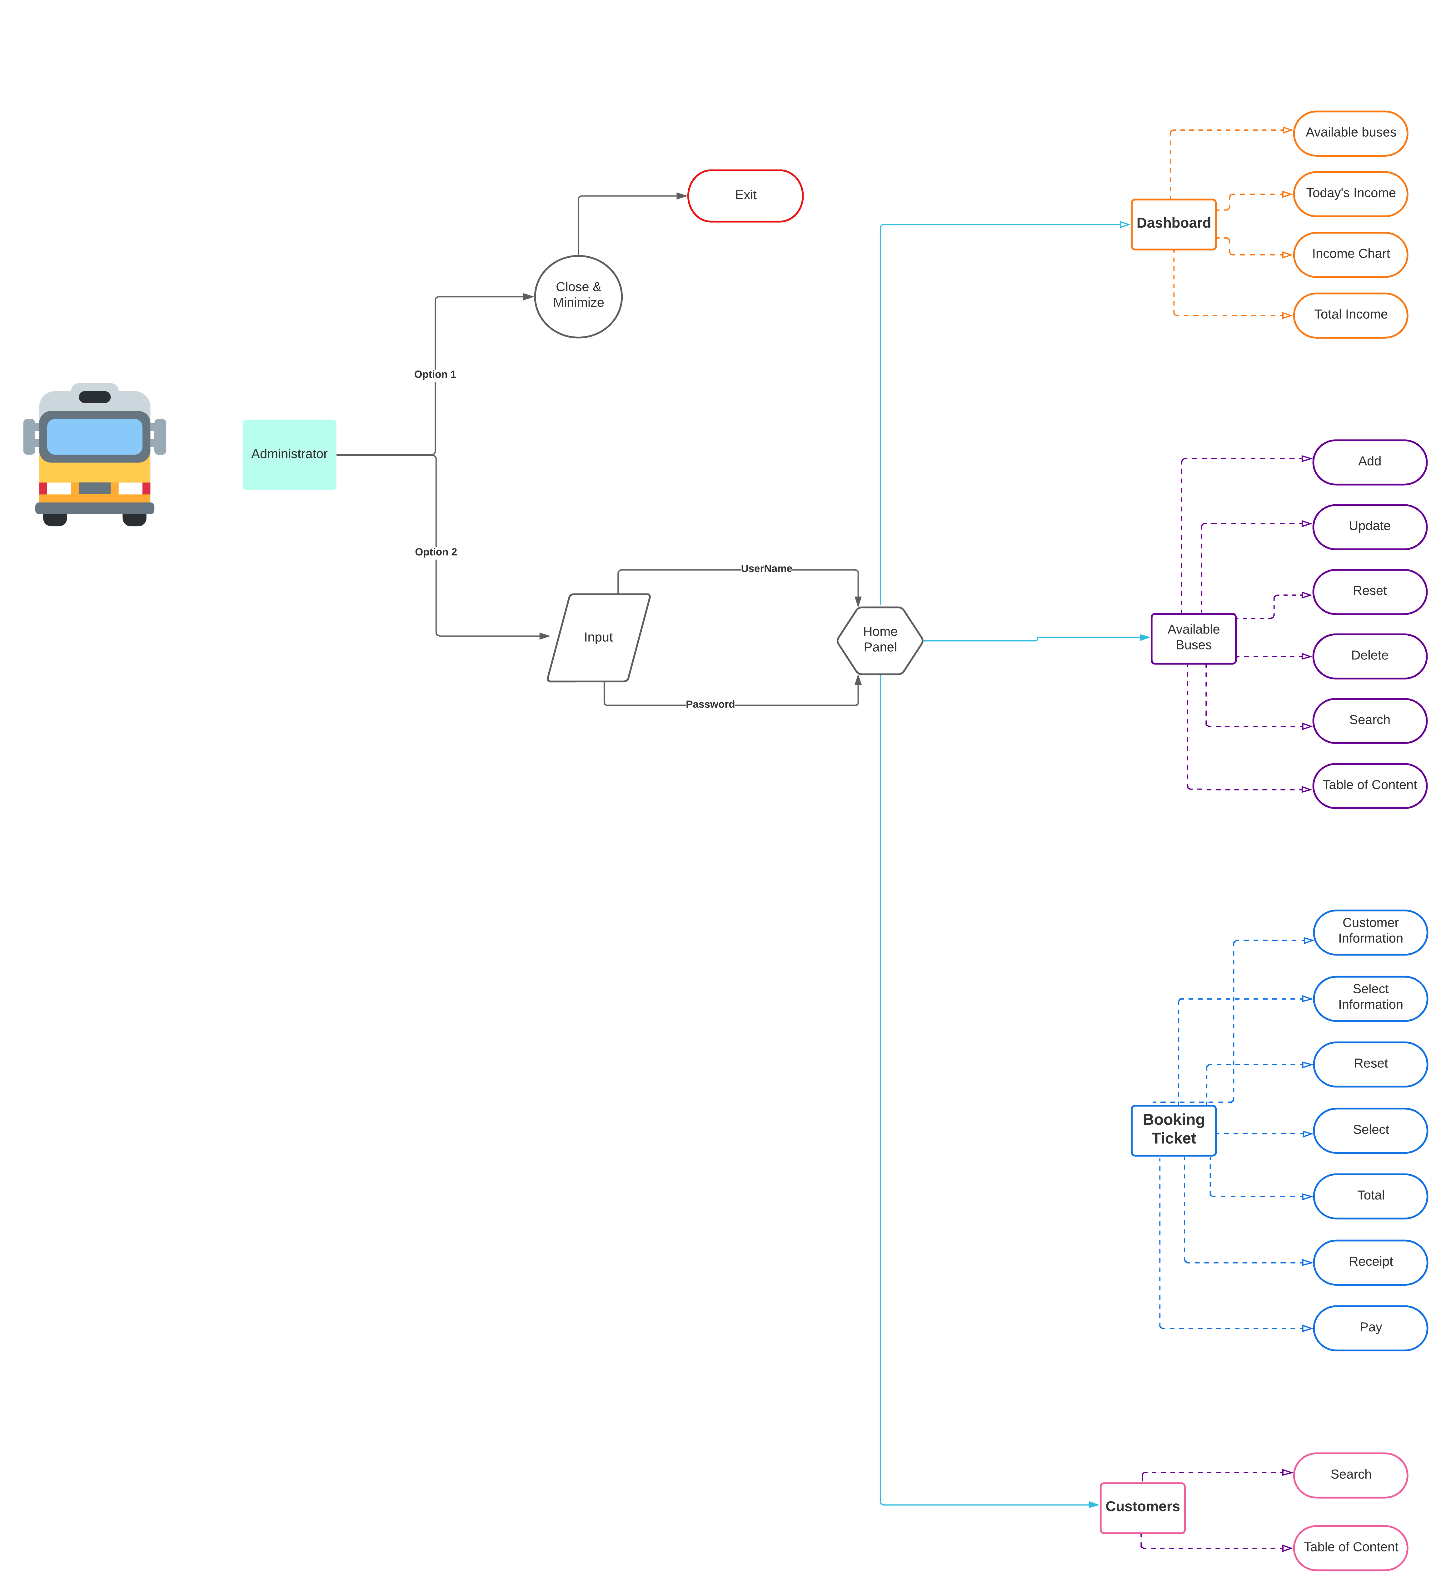
ER Diagram

Slide 11
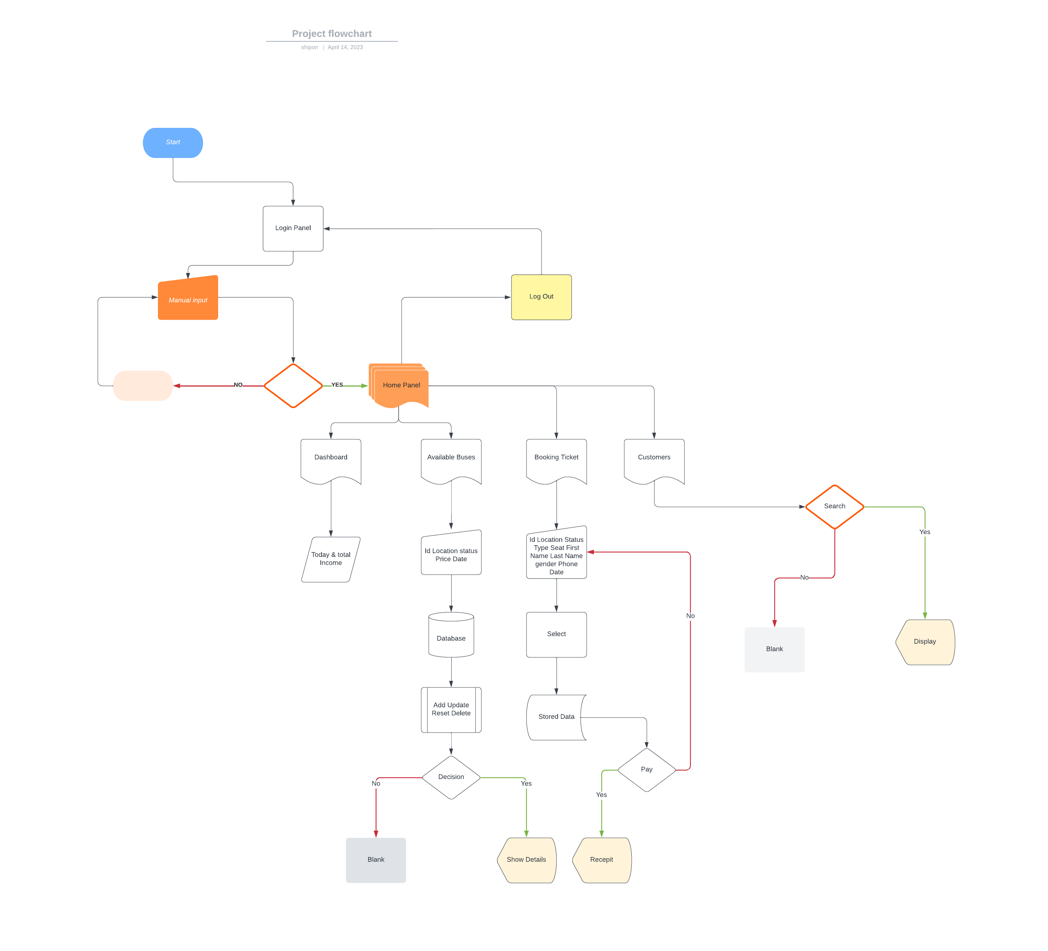
Use Case Diagram

Slide 12
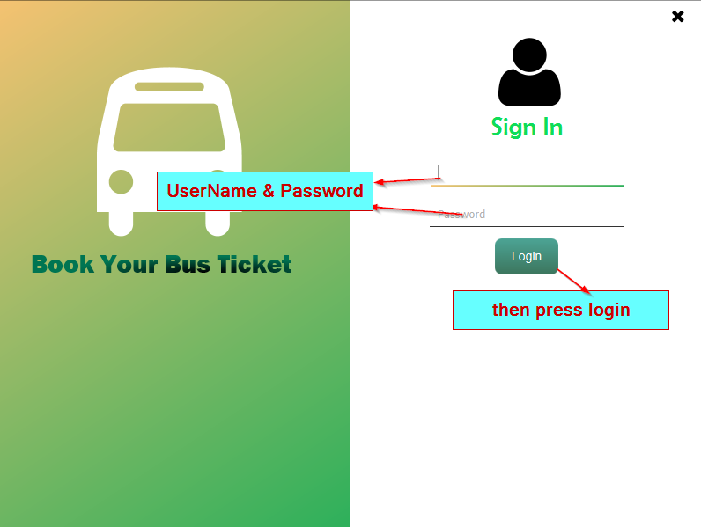
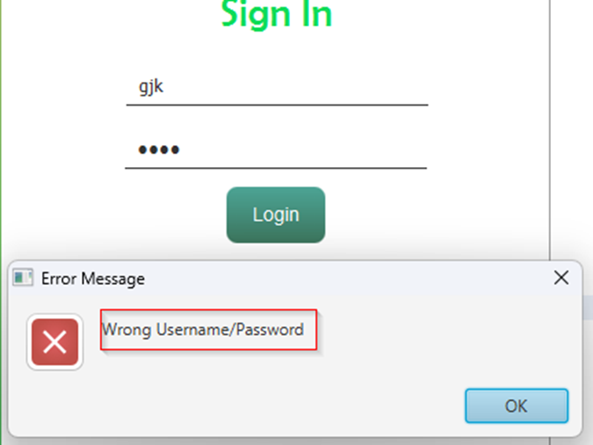
How to use System

Slide 13
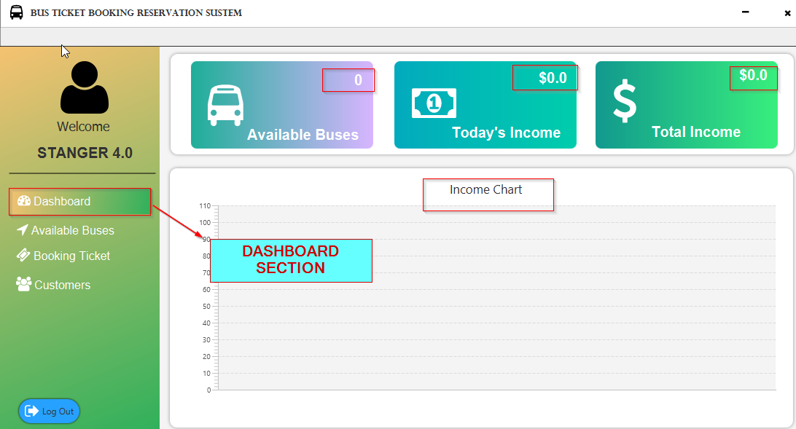
How to use System

Slide 14
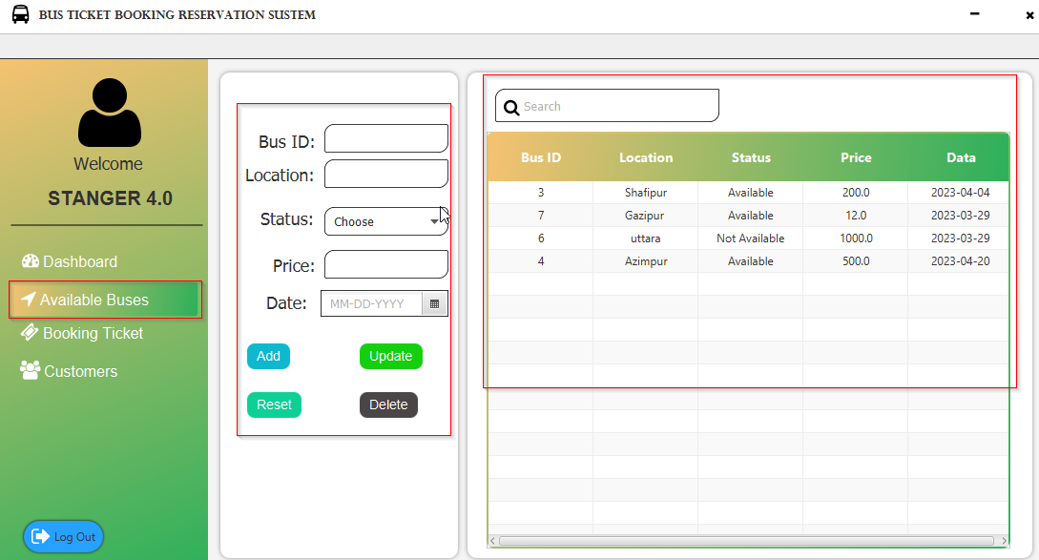
Available Buses

Slide 15
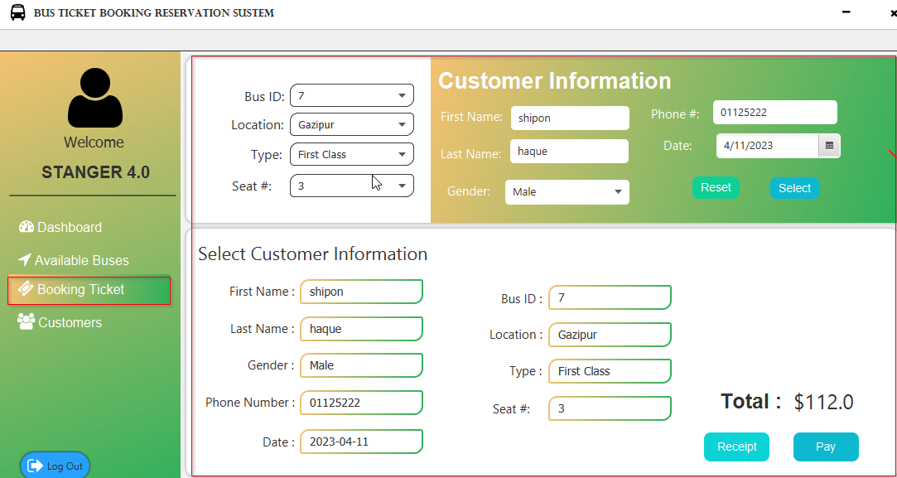
Booking Ticket Panel

Slide 16
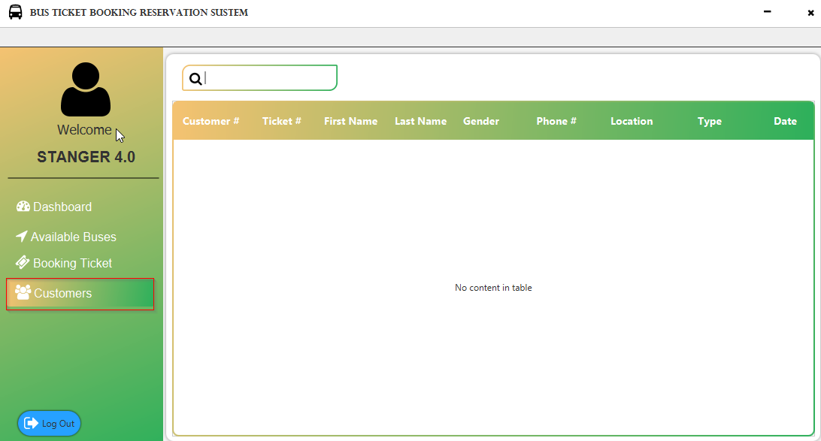
Customers Pane

Slide 17
Conclusion
This bus management system which provides online reservation of bus.
This system is user friendly and accurate.
This system is available and efficient in reservation.
It has no hidden costs.

